Slide 1
Test | Positive Predictive value (present accuracy) | Negative Predictive value (not present accuracy) | Binary Accuracy | Actual Per Square Accuracy | Notes
No rotation | 65/80 = .8125 | 1 | (56 + 65)/(56+80) = 0.8897 | 0.8979 | Least accurate, not considered, strictly worse than rotation
Rotation | 74/79 = 0.9367 | 1 | (56 + 74)/(56 + 79) = 0.9630 | 0.9554 | More accurate with black t-shirts Less accurate with a variety of colored shirts (i.e. not black or white)
Rotation + Hist. Eq. | 74/79 = 0.9367 | 1 | (56 + 74)/(56 + 79) = 0.9630 | 0.9476 | Less accurate with black t-shirts More accurate with a variety of colored shirts (i.e. not black or white)
Rotation + Hist. Eq. + Whites | 174/179 = 0.9721 | 1 | (174+56)/(56+179) = 0.9790 | (171.60999999999999 + 55.9908928571)/(56+179) = 0.9685 | Inflated due to 100% accuracy on 80+ white t-shirts, in reality is usually less accurate on non-white images than when whites are included in training set . Actual comparable accuracy is 0.9452

Slide 2
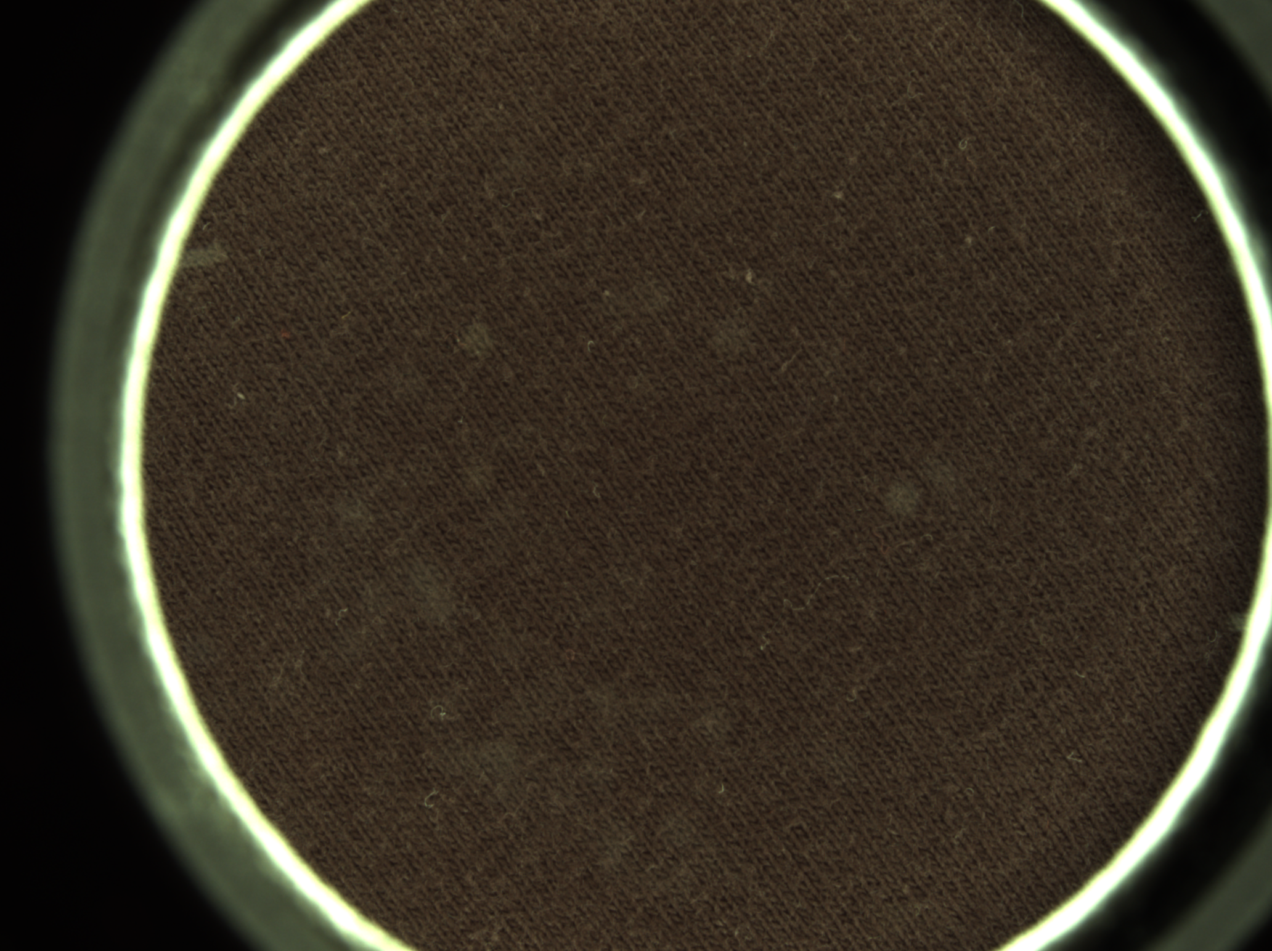
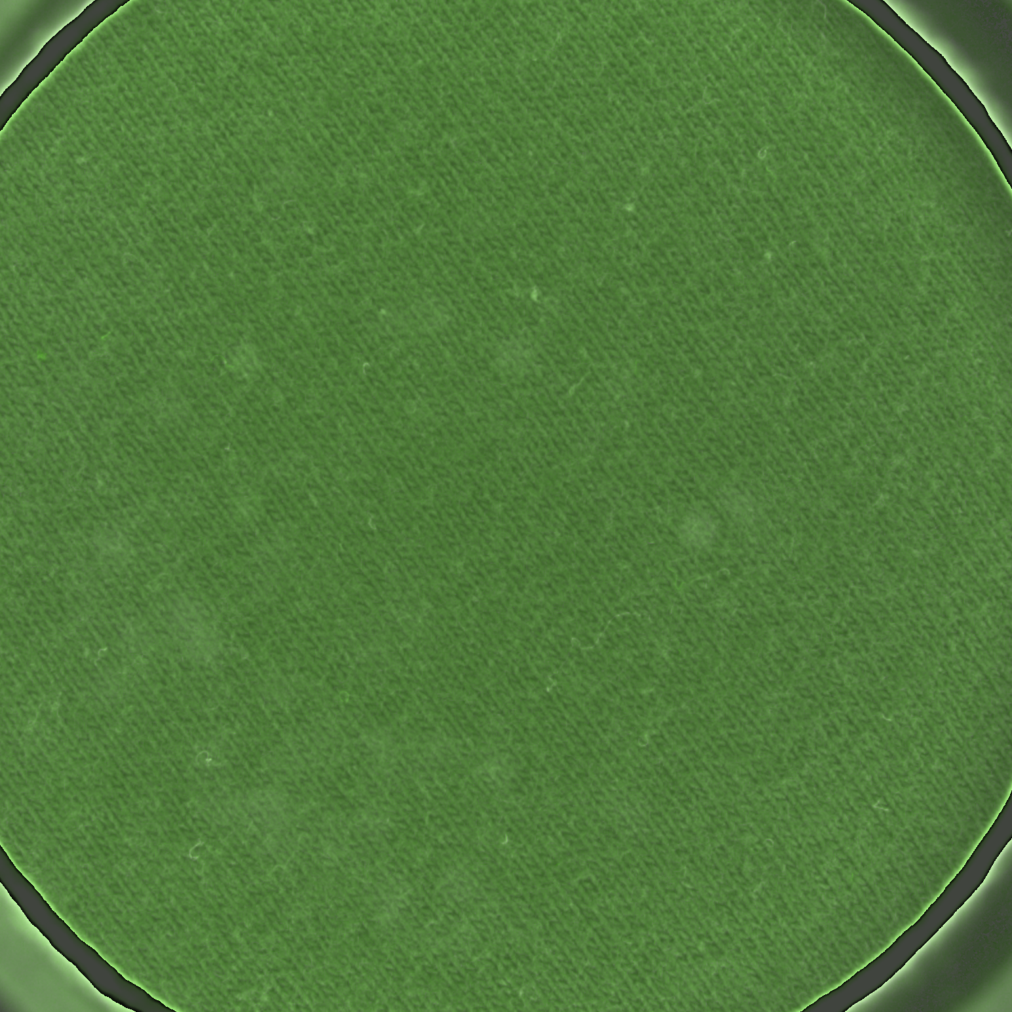
Notable differences: BLACK TSHIRTS
ROTATION WITHOUT HIST EQ | ROTATION + HIST EQ
avg = 1.0; black (1).png present prediction: 1 avg = 1.0; black (10).png present prediction: 1 avg = 0.57; black (2).png present prediction: 1 avg = 0.53; black (3).png present prediction: 1 avg = 0.5; black (4).png present prediction: 0 avg = 0.53; black (5).png present prediction: 1 avg = 0.53; black (6).png present prediction: 1 avg = 1.0; black (7).png present prediction: 1 avg = 1.0; black (8).png present prediction: 1 avg = 1.0; black (9).png present prediction: 1 | avg = 0.92; black (1).png present prediction: 1 avg = 0.96; black (10).png present prediction: 1 avg = 0.09; black (2).png present prediction: 0 avg = 0.1; black (3).png present prediction: 0 avg = 0.05; black (4).png present prediction: 0 avg = 0.1; black (5).png present prediction: 0 avg = 0.13; black (6).png present prediction: 0 avg = 0.94; black (7).png present prediction: 1 avg = 0.95; black (8).png present prediction: 1 avg = 0.97; black (9).png present prediction: 1

Slide 3
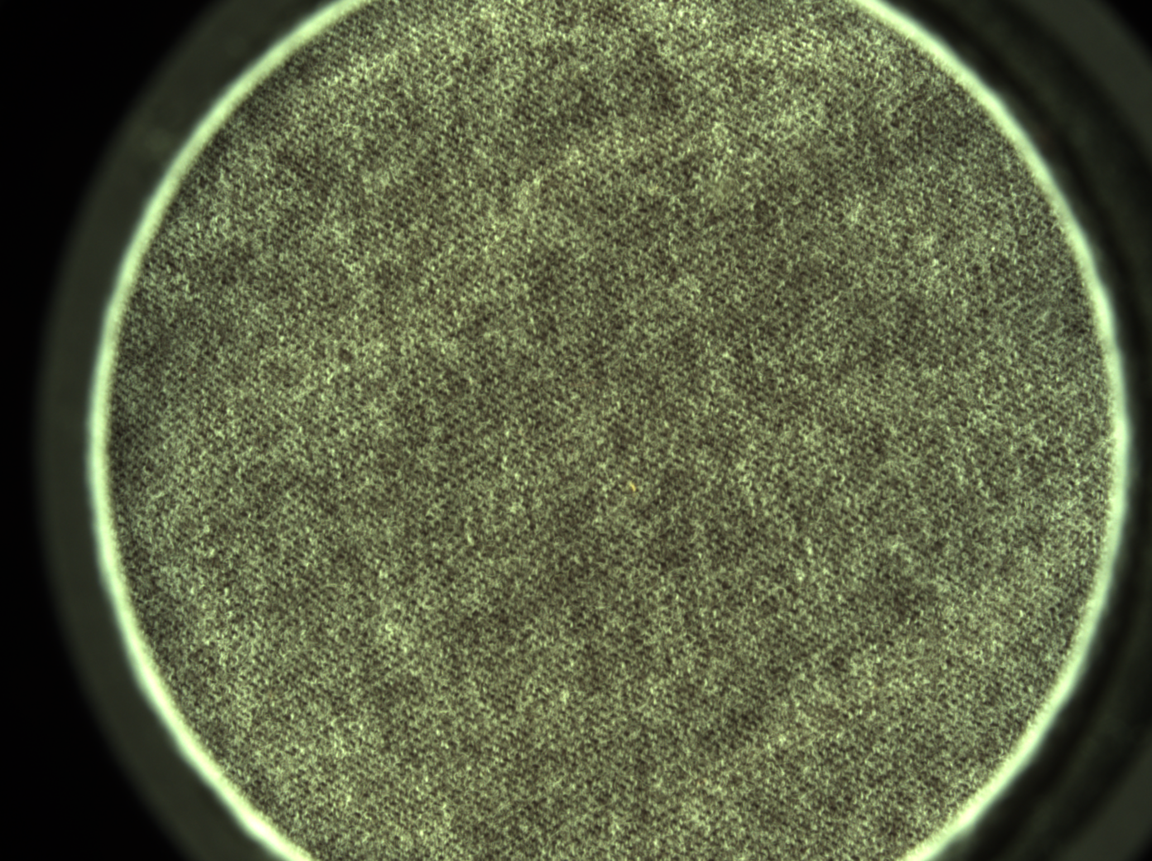
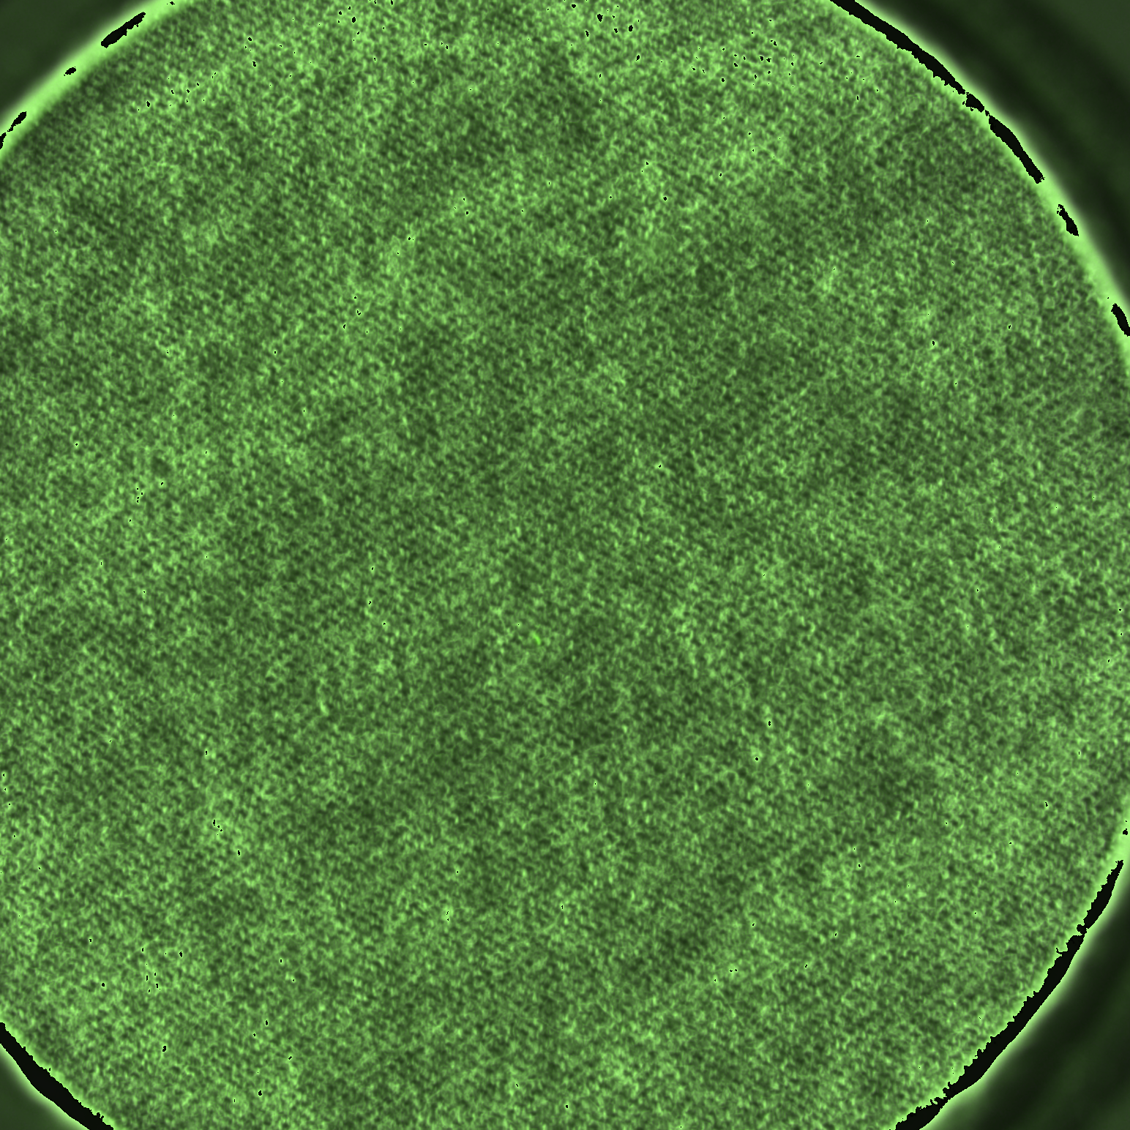
Dark Gray TSHIRTS
ROTATION WITHOUT HIST EQ | ROTATION + HIST EQ
avg = 0.56; dark_gray (1).png present prediction: 1 avg = 0.47; dark_gray (10).png present prediction: 0 avg = 1.0; dark_gray (2).png present prediction: 1 avg = 1.0; dark_gray (3).png present prediction: 1 avg = 1.0; dark_gray (4).png present prediction: 1 avg = 1.0; dark_gray (5).png present prediction: 1 avg = 1.0; dark_gray (6).png present prediction: 1 avg = 0.37; dark_gray (7).png present prediction: 0 avg = 0.35; dark_gray (8).png present prediction: 0 avg = 0.42; dark_gray (9).png present prediction: 0 | avg = 0.93; dark_gray (1).png present prediction: 1 avg = 0.9; dark_gray (10).png present prediction: 1 avg = 1.0; dark_gray (2).png present prediction: 1 avg = 1.0; dark_gray (3).png present prediction: 1 avg = 1.0; dark_gray (4).png present prediction: 1 avg = 1.0; dark_gray (5).png present prediction: 1 avg = 1.0; dark_gray (6).png present prediction: 1 avg = 0.93; dark_gray (7).png present prediction: 1 avg = 0.95; dark_gray (8).png present prediction: 1 avg = 0.87; dark_gray (9).png present prediction: 1

Slide 4
Testing colors against each other
Color | PPV | NPV | Binary Accuracy | Actual Accuracy
Yellow | 1 | 0.9955357142857142 | 1 | 0.9962121212121212
Black | 0.9530000000000001 | 0.9946428571428572 | 1 | 0.9883333333333332
Blue | 1 | 0.9974999999999998 | 1 | 0.9978787878787879
Dark Gray | 1 | 0.9977777777777778 | 1 | 0.9981132075471698
Dark Gray 2 | 1 | 0.9977777777777778 | 1 | 0.9977272727272727
Dark Blue | 1 | 0.9957142857142858 | 1 | 0.9964179104477613
Purple | 1 | 0.9969642857142856 | 1 | 0.9974242424242424
Light Gray | 1 | 0.9973214285714285 | 1 | 0.9977272727272727
White | 1 | 0.9984999999999999 | 1 | 0.9994375

Slide 5
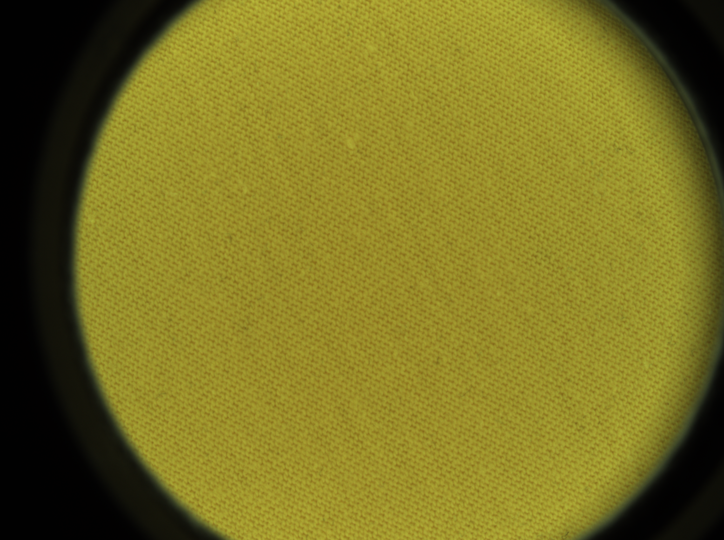
Yellow

Slide 6
Black

Slide 7
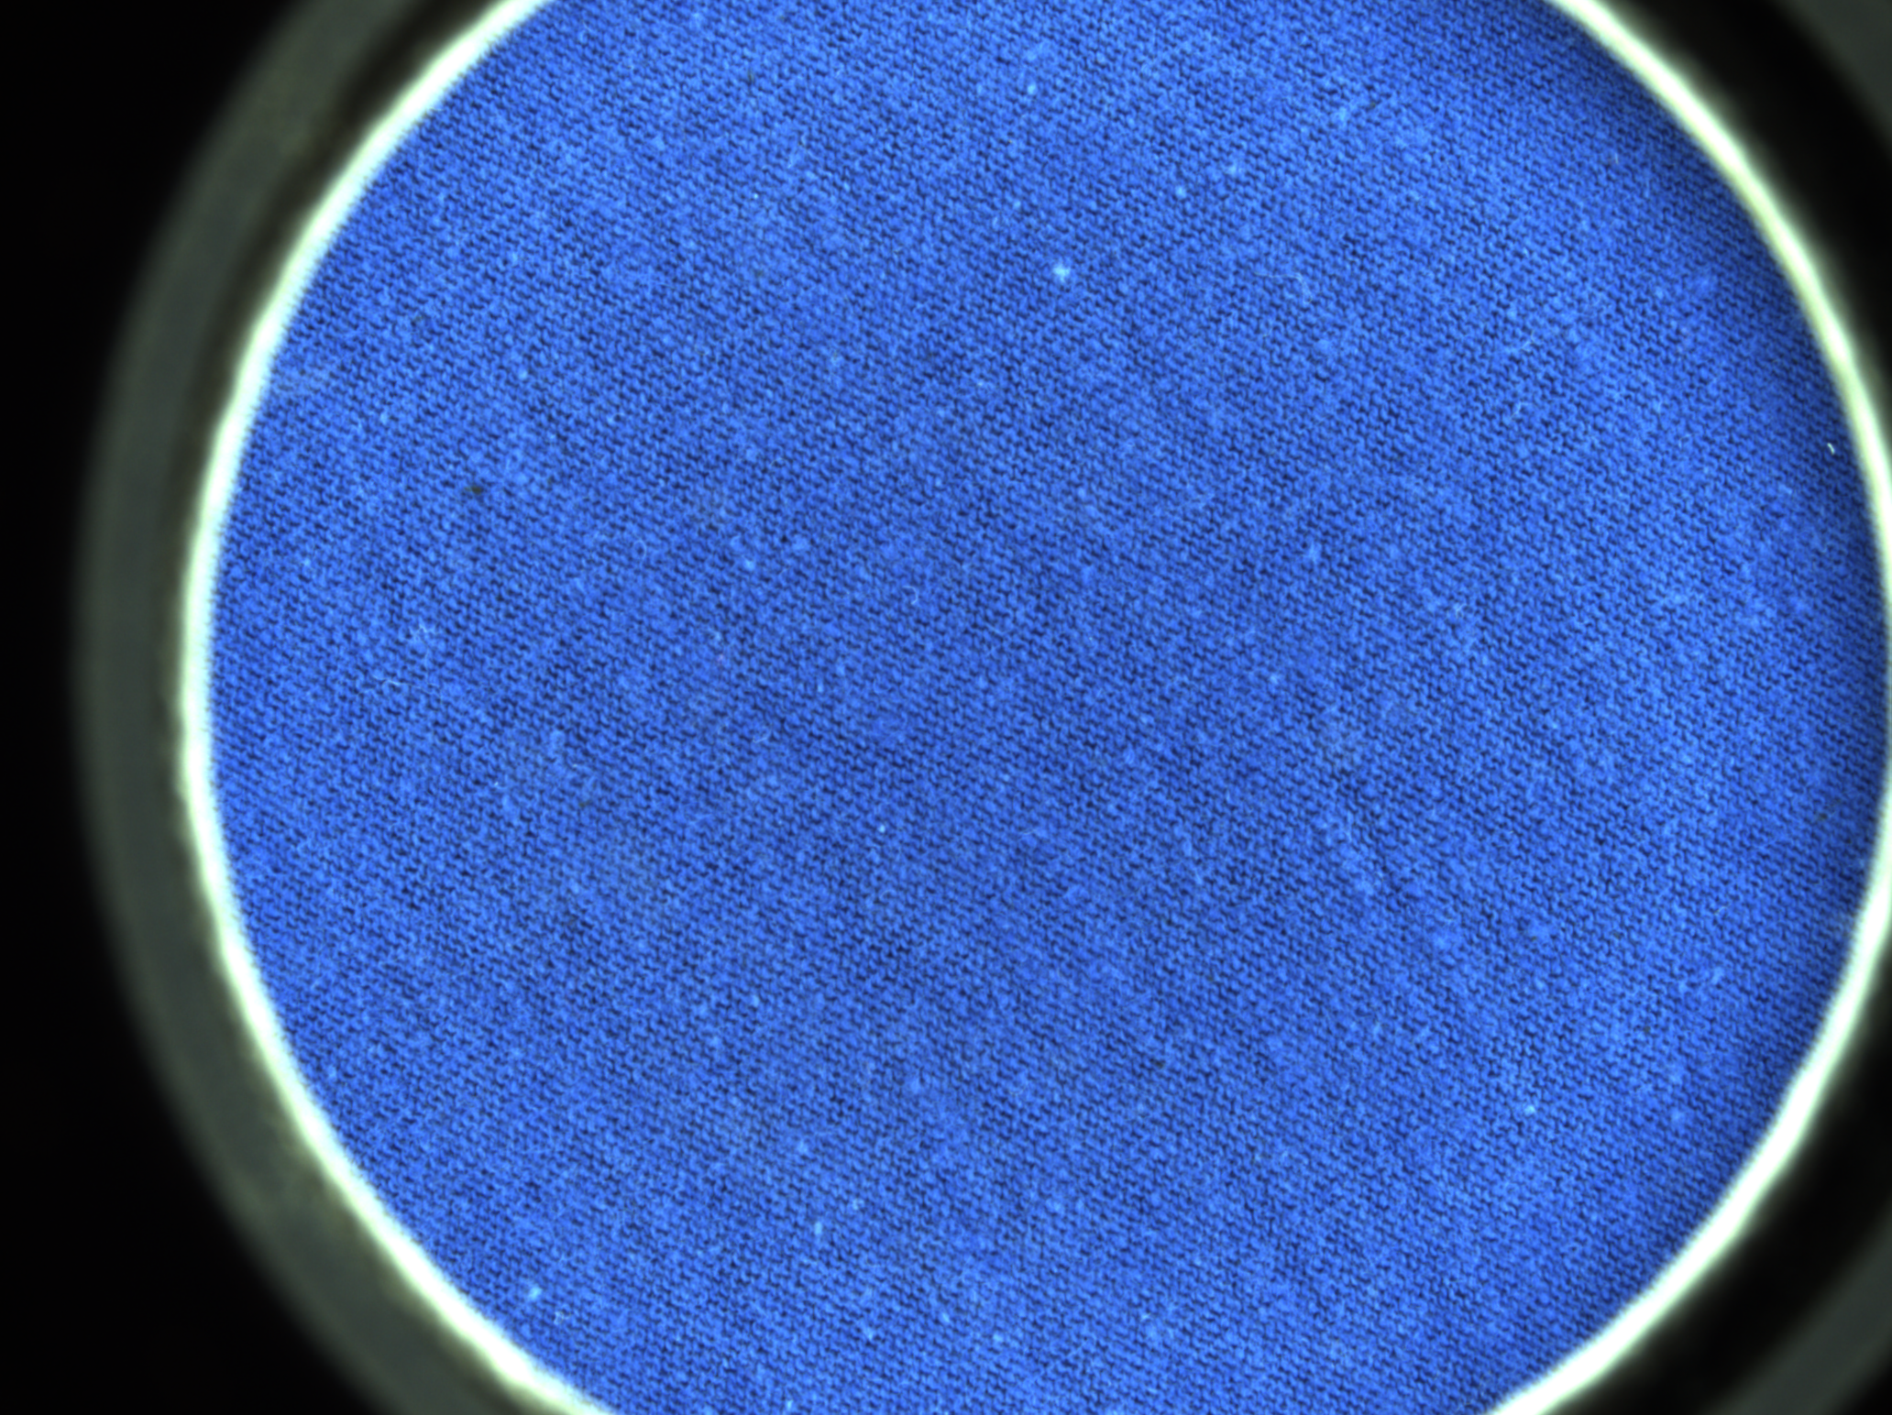
Blue

Slide 8
Dark Gray

Slide 9
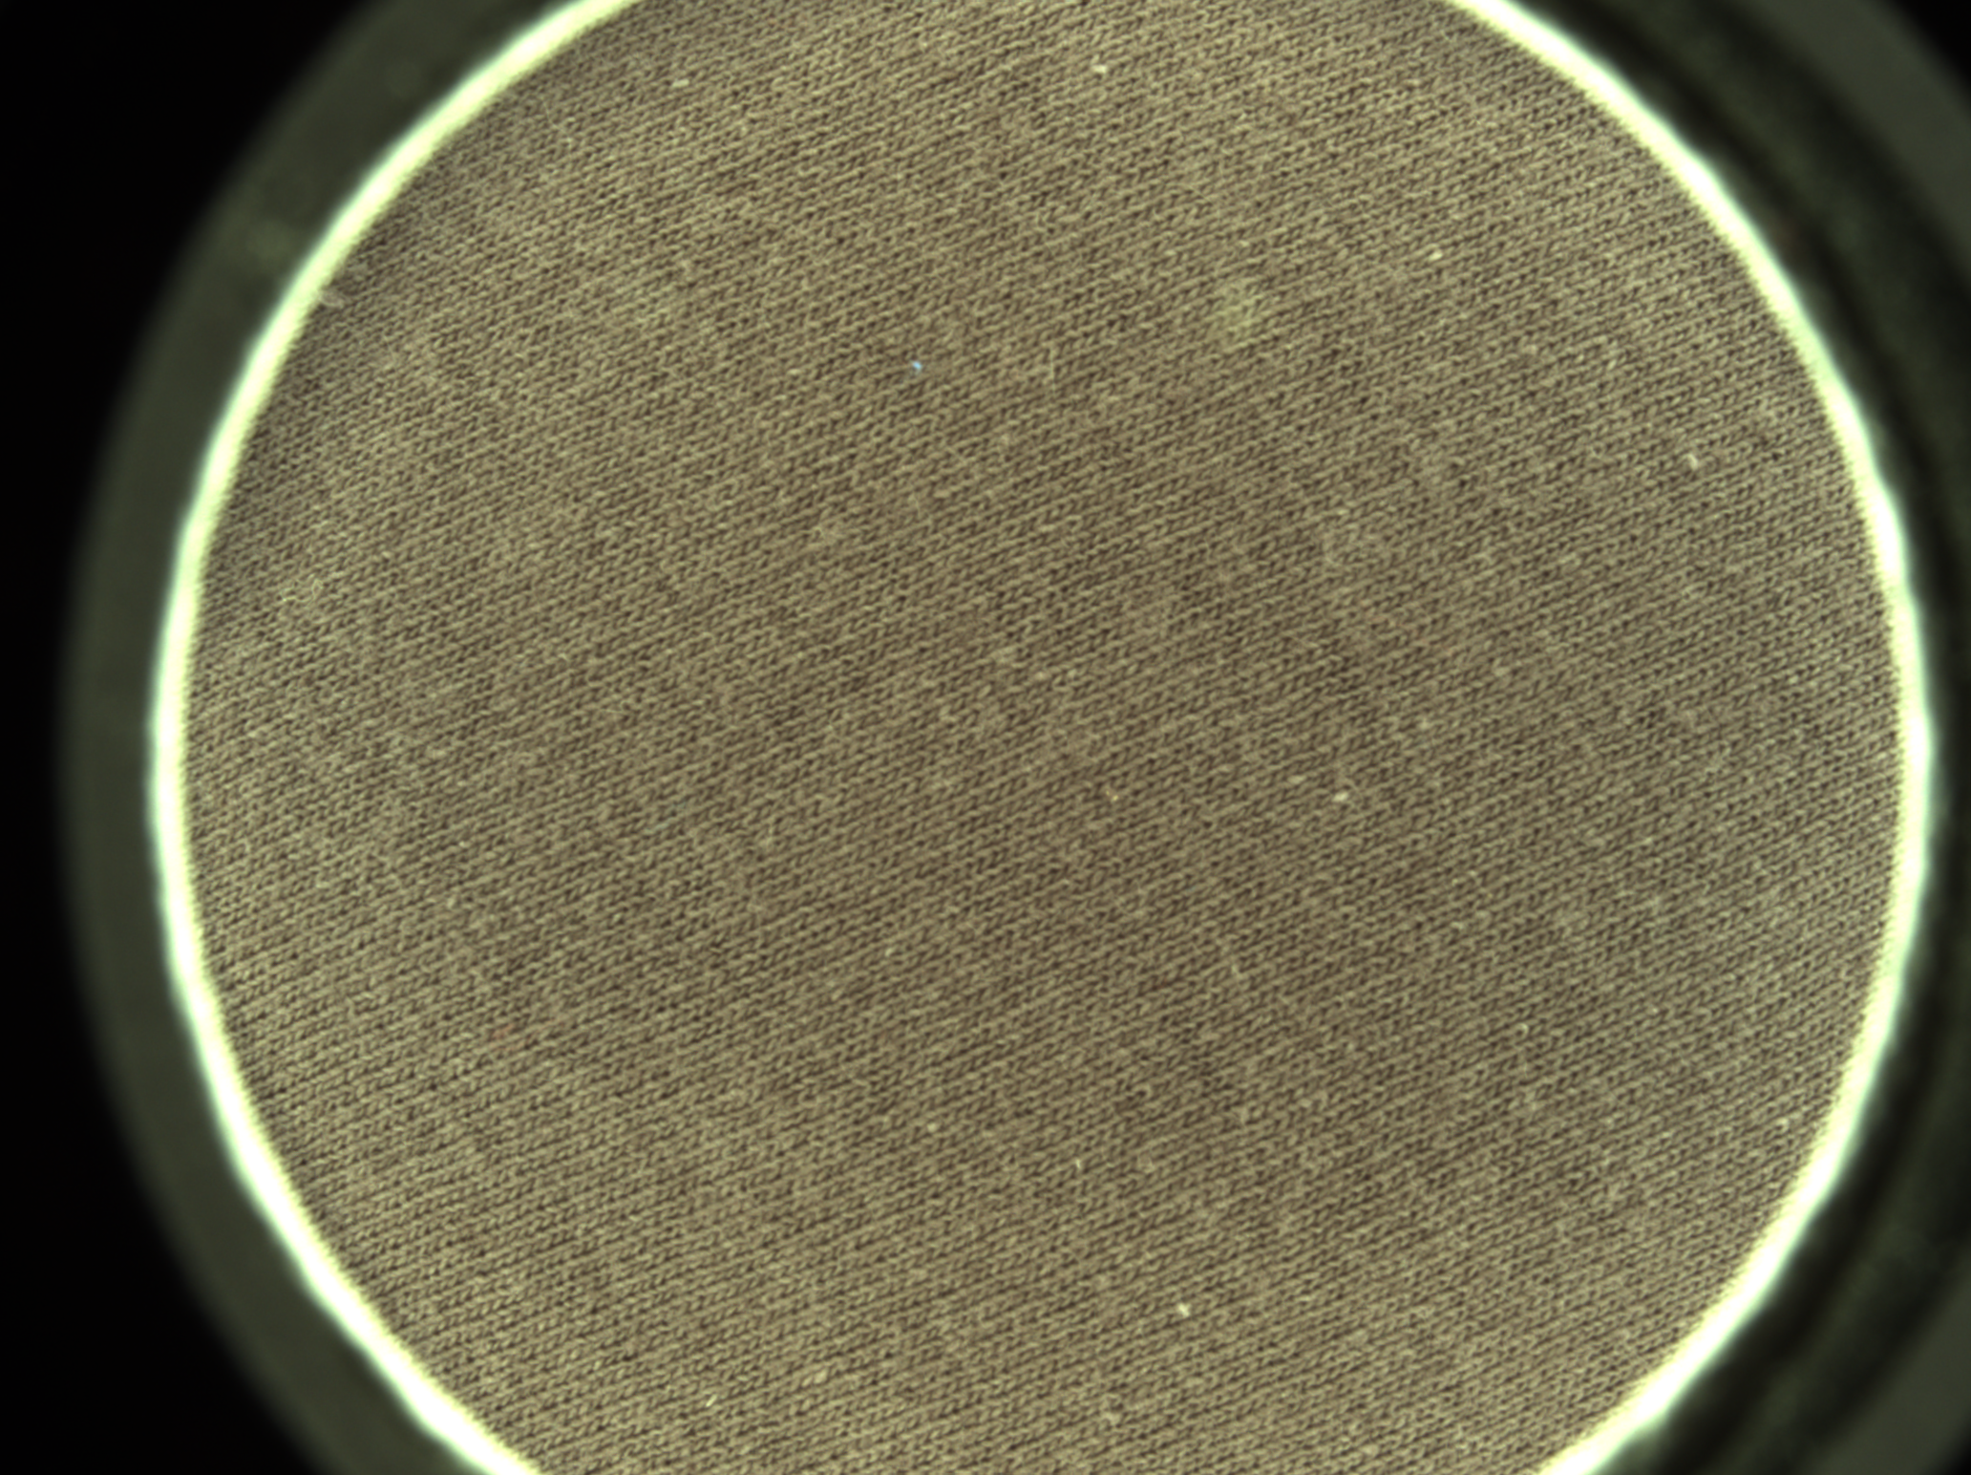
Dark Gray 2

Slide 10
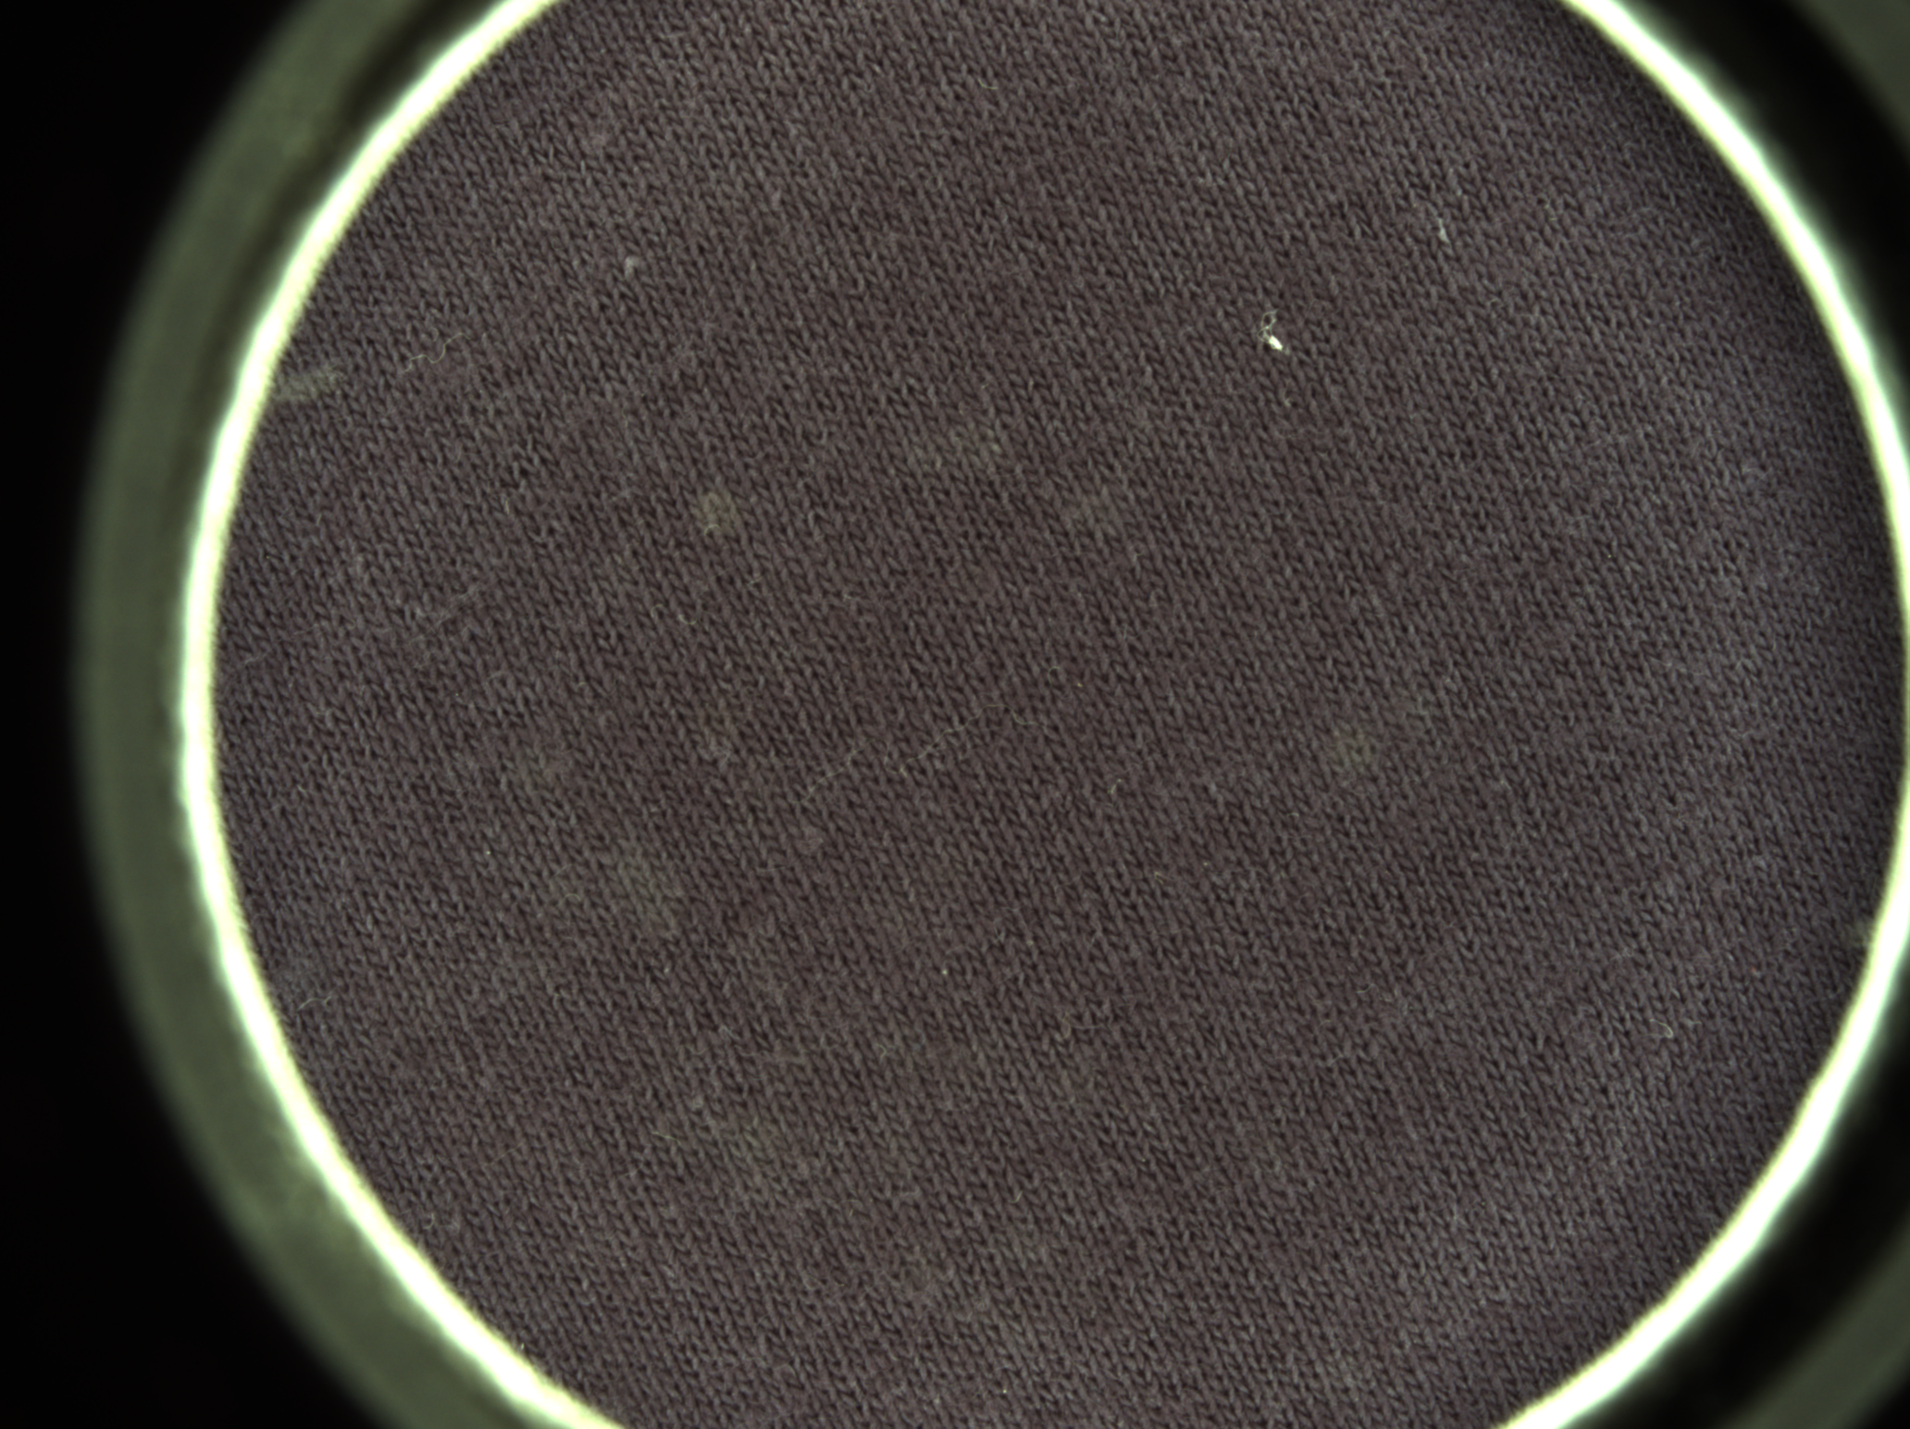
Dark Blue

Slide 11
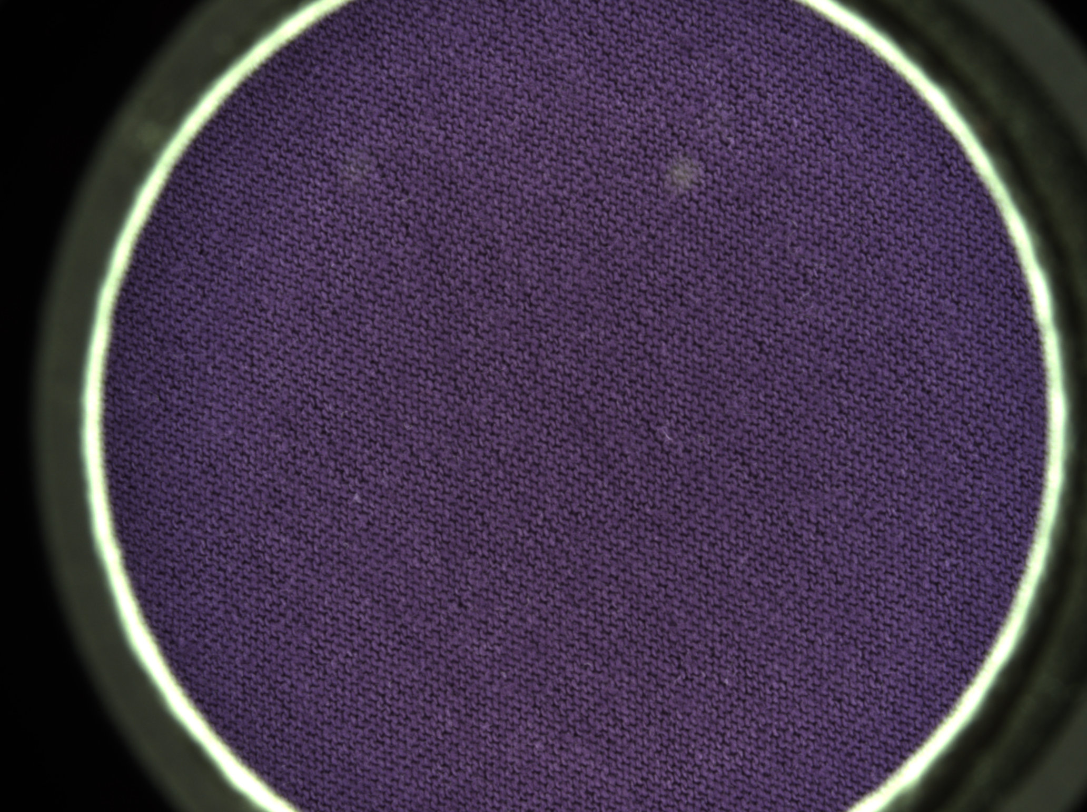
Purple

Slide 12
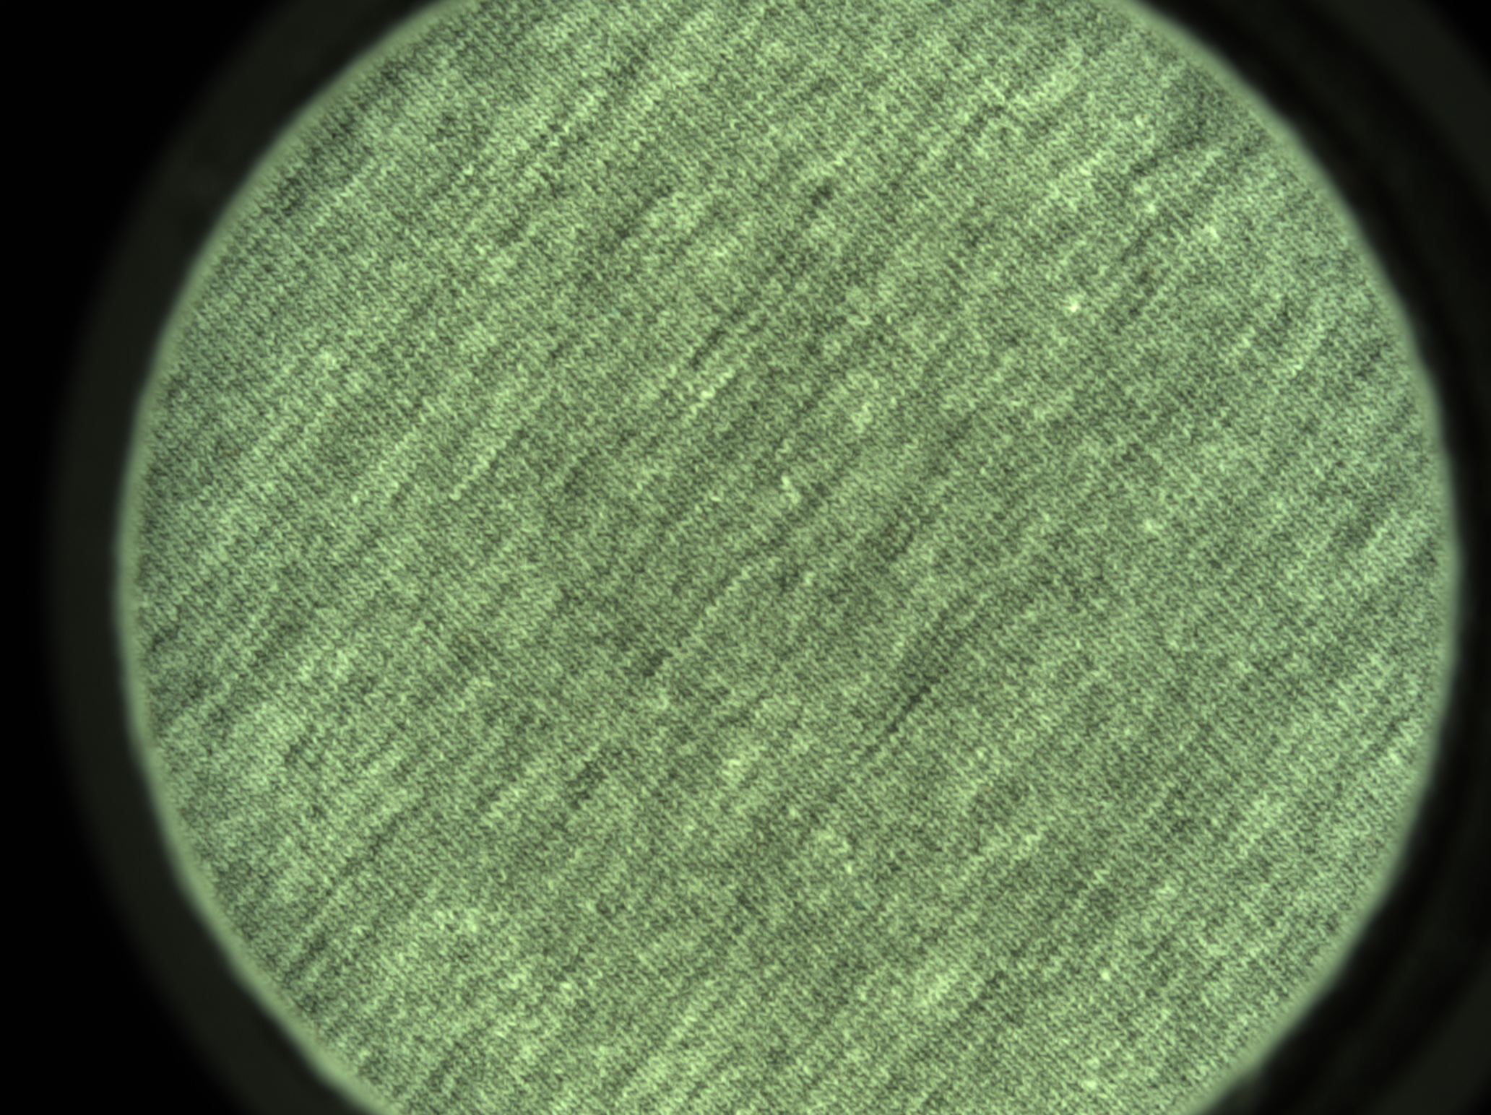
Light Gray

Slide 13
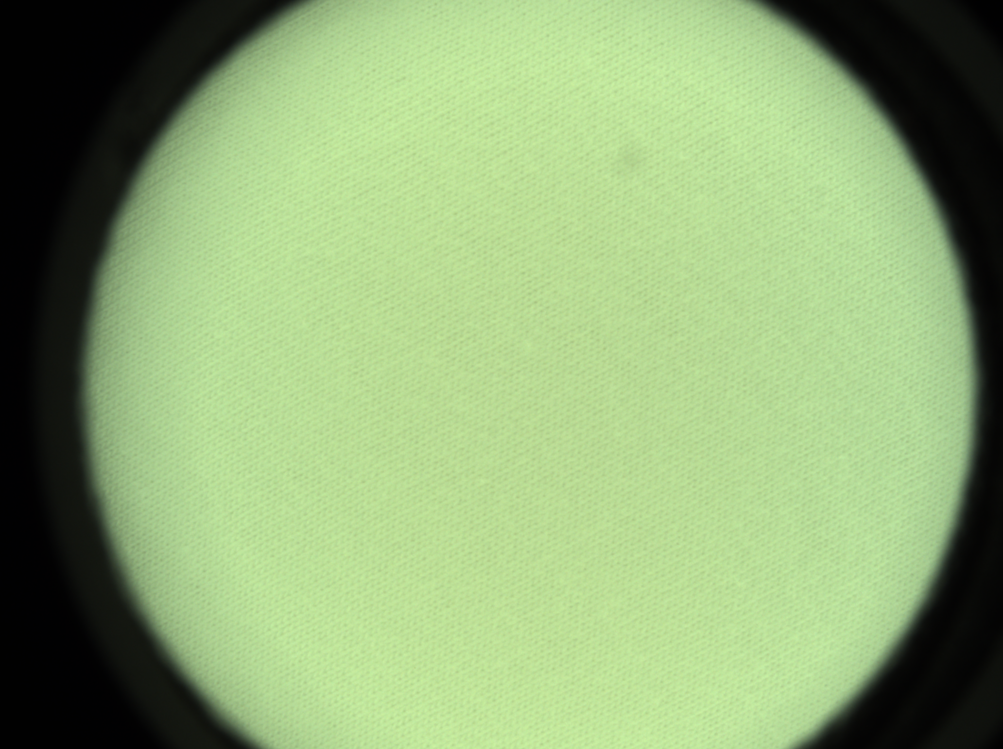
White

